Slide 1

Federated Learning for Urban Morphology
Mayuresh Hooli
Mason Jerome

Slide 2
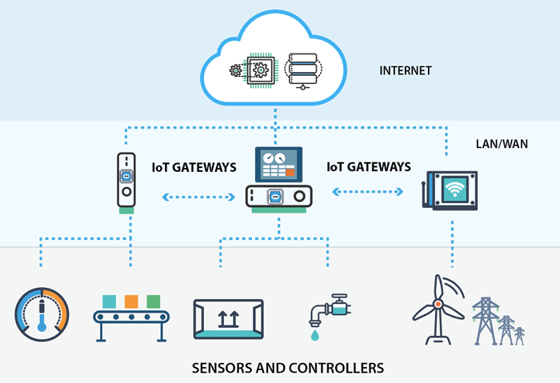
Introduction
The most important aspect of Internet of Things is the data acquisition
We collect, clean, organize and analyze this data to get insights
Earlier, the devices we used to gather data were small sensors that would detect, temperature, pressure, moisture, etc.
Today, with the advancements in IoT, we can acquire data through imaging devices as well
Source: Zibtek

Slide 3
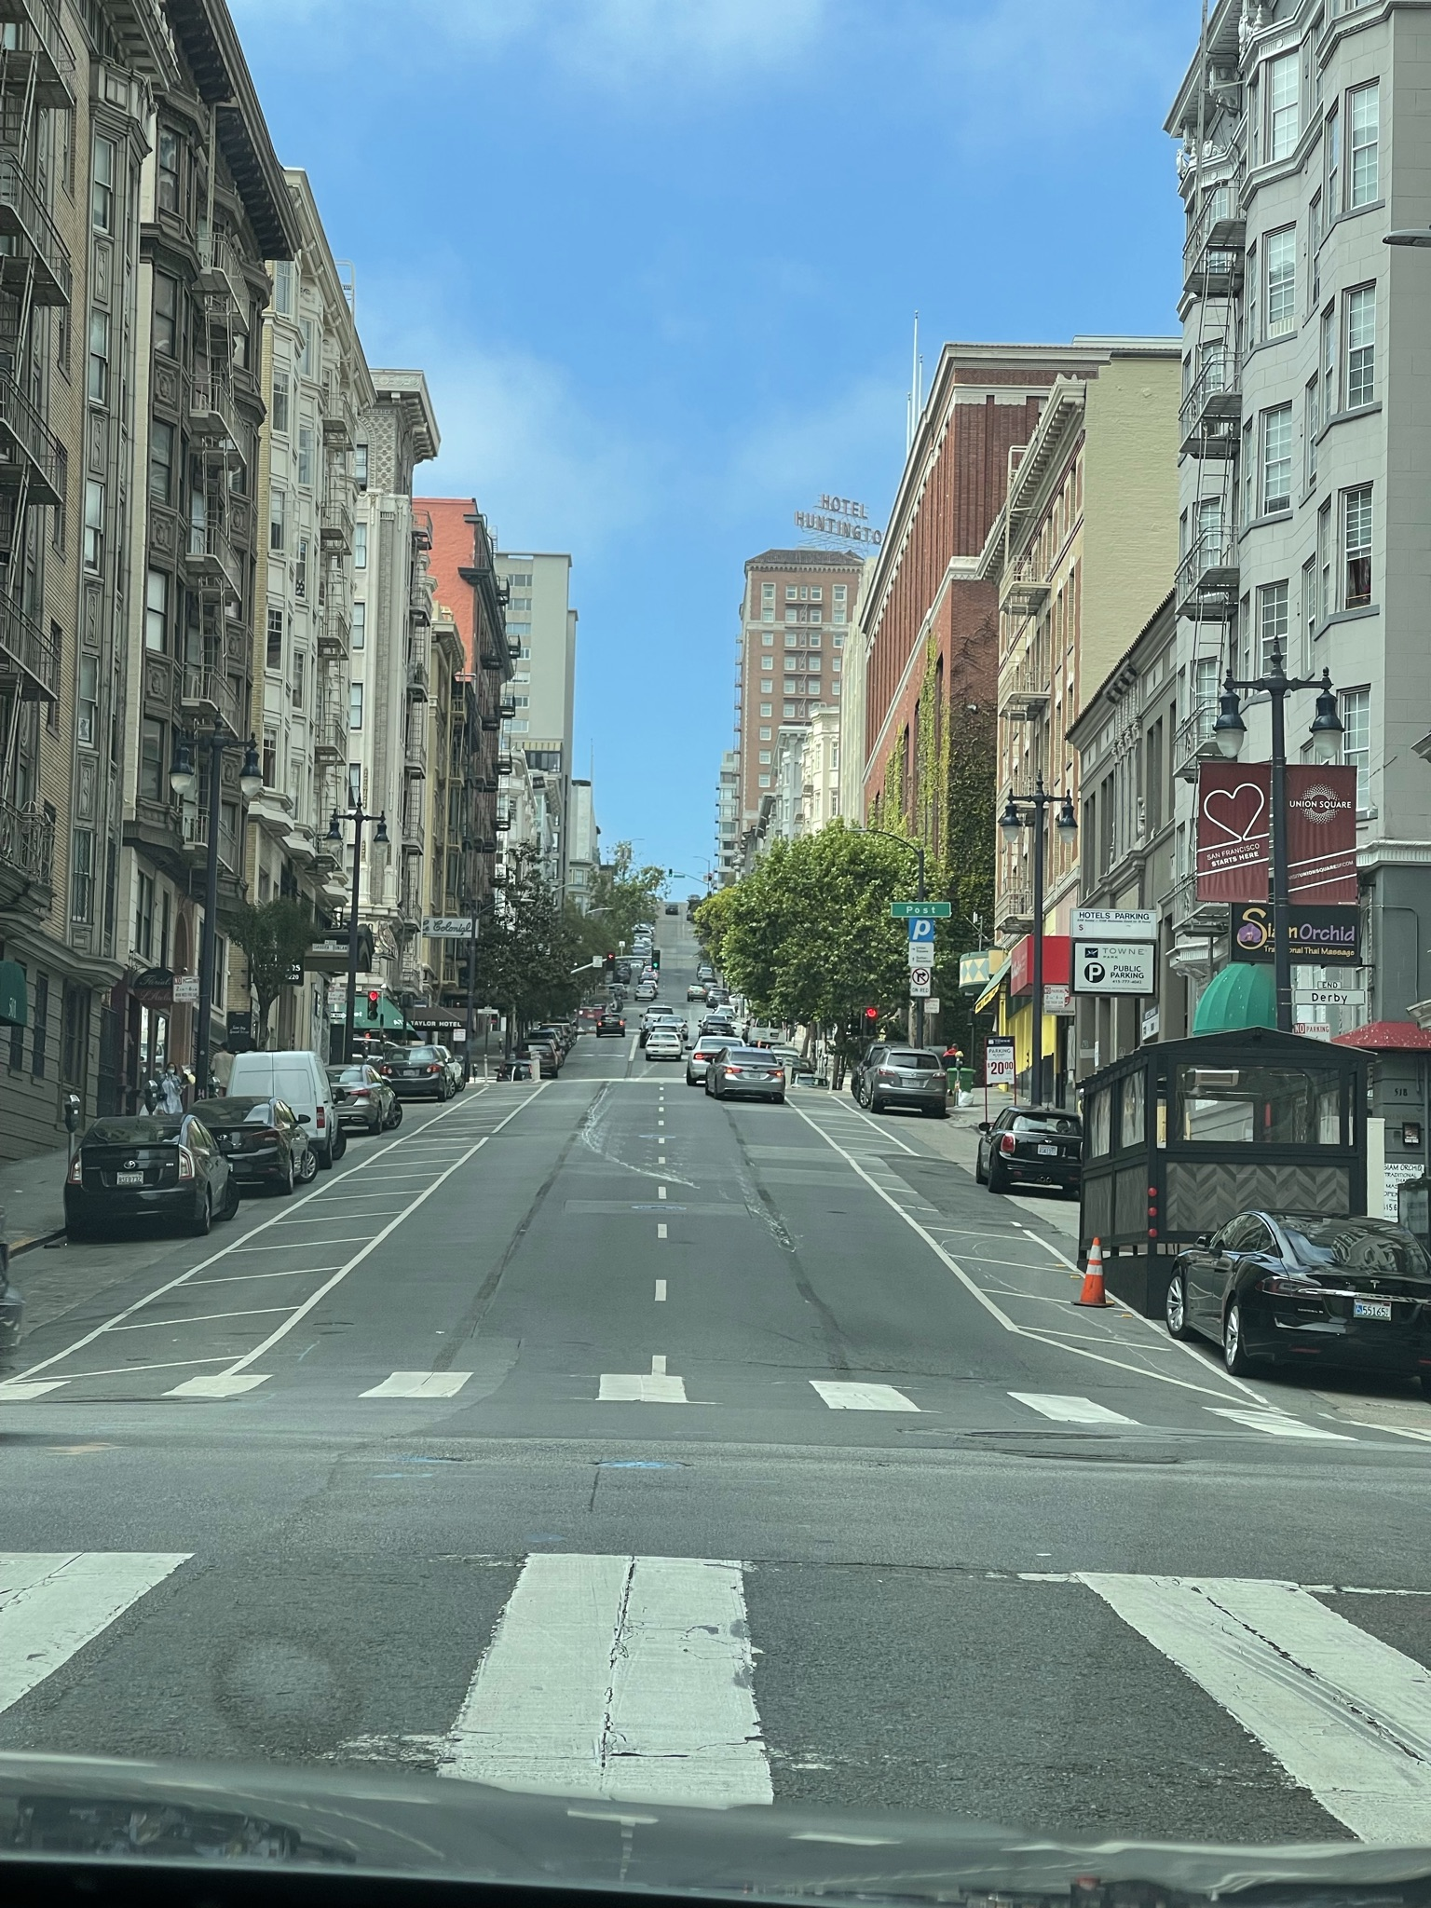
Morphology
Through the use of imaging devices, we were able to gather the morphology data of various urban areas across USA
Identifying the morphology of an area helps us with the following applications:
Self-driving cars
Construction
Buildings
Roads
Telecommunication

Slide 4
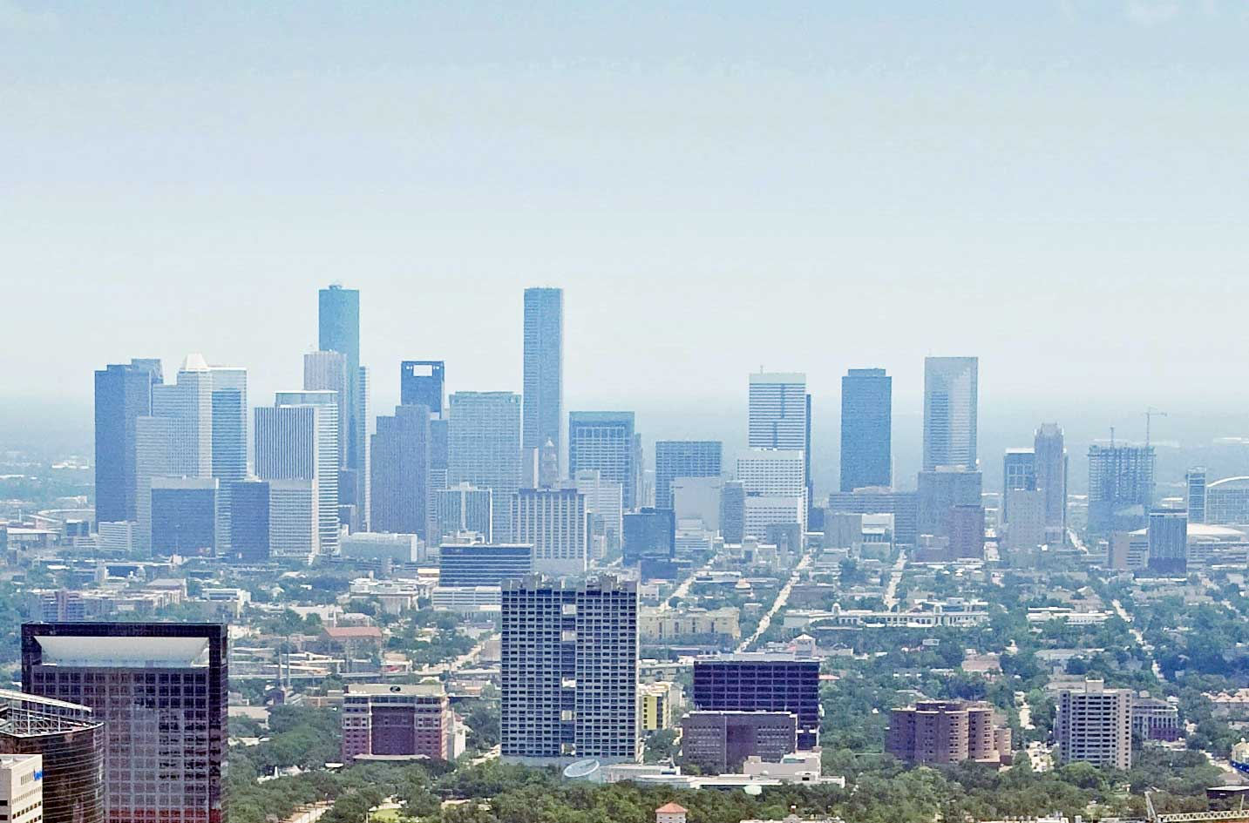
Urban Classes
Most of the urban and metropolitan areas across USA have a huge sprawl
There are high-rise buildings and next to it are single-family houses
As this dataset needs to be more generalized, we added the middle housing here as well
This gives us a total of 3 main classes:
Urban/Dense Urban
Mid-Urban
Suburban

Slide 5
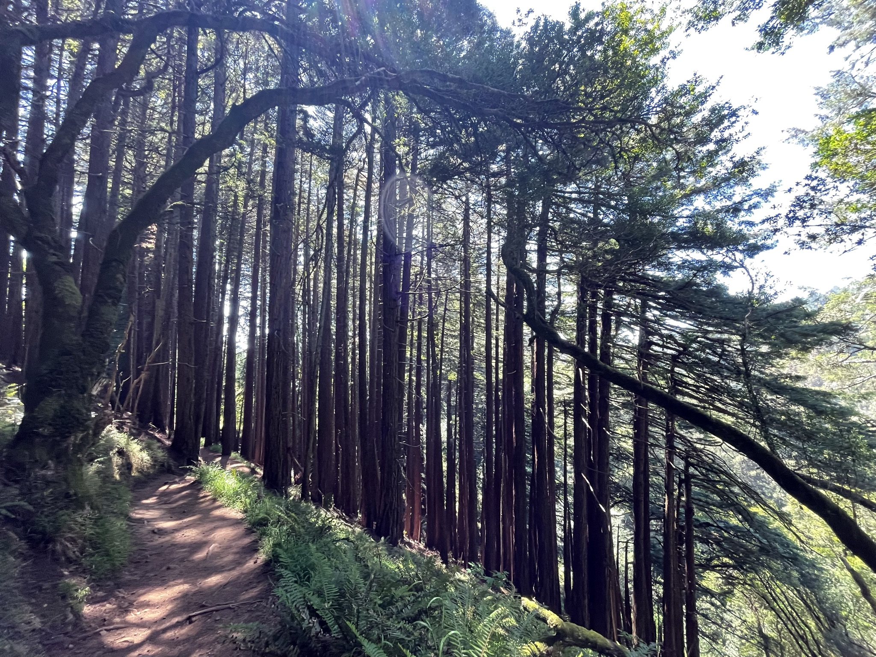
Tree Classes
As with the urban density, the type of trees in that area will tell us a lot about it
Here, we look at density and type of trees
The density of trees can be divided into 3 types:
Low Foliage
Mid Foliage
High Foliage
There are 3 types of tree coverage:
Coniferous
Deciduous
Mixed
This coverage is used mainly for suburban areas, not dense or mid-urban

Slide 6
Morphology Classes
Based on the slides above, we have 10 classes for urban morphology:
Dense Urban High Foliage
Dense Urban Low Foliage
Mid Urban High Foliage
Mid Urban Low Foliage
Suburban High Foliage Deciduous
Suburban High Foliage Coniferous
Suburban High Foliage Mix
Suburban Low Foliage Deciduous
Suburban Low Foliage Coniferous
Suburban Low Foliage Mix

Slide 7
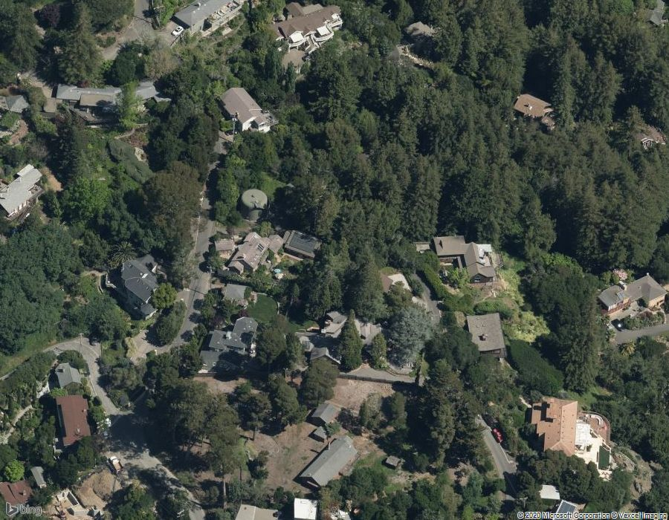
Data Acquisition
Various suburban areas were identified with these urban morphology types
The images were available on Bing Maps through a subscription of Microsoft Azure (unfortunately not free, but Google was more expensive)
This was since Bing Maps would give us the images we were looking for from a different angle

Slide 8
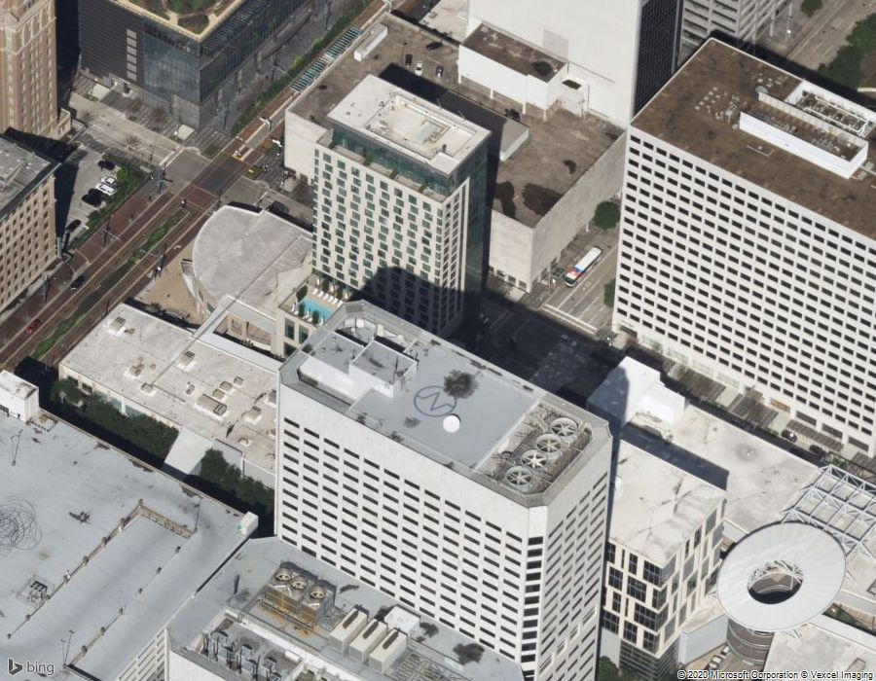
Data Acquisition (Continued)
The images collected were 900×700 pixels
Each area on the map was looked at from 4 different perspectives
Looking at the map from just one perspective may not always be right since we tend to miss a few things
These 4 perspectives need to work together, so we considered using Federated Learning

Slide 9
Federated Learning
Federated Learning is a decentralized form of Machine Learning
This is used on Edge devices or Servers that hold local data samples
This approach contrasts the traditional machine learning algorithms where the analysis is performed on a centralized data set
The federated learning algorithms have two distinct advantages over traditional machine learning algorithms
Faster response time: Sending the data to the central server and receiving it again is a slow process, while performing analytics locally is much faster
Security: The centralized data storage may or may not be secure and depend on various factors, including politics

Slide 10
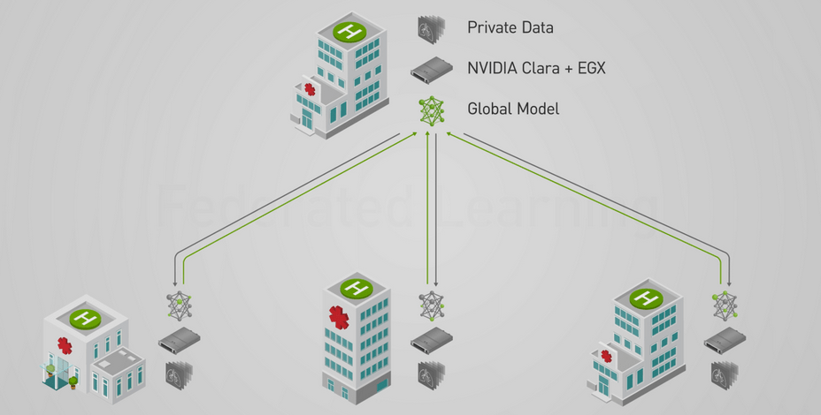
Federated Learning
Training:
Local machine learning models are trained on local heterogeneous datasets
These create local training datasets in each users’ device.
The parameter are exchanged periodically for each of these models, while the local data samples are not shared
This helps build a global model
The characteristics of the global model are shared with local data centers for creating a local model
Inference:
Model is stored on the user device so predictions are quickly prepared using the model on the user device
Source: NVIDIA

Slide 11
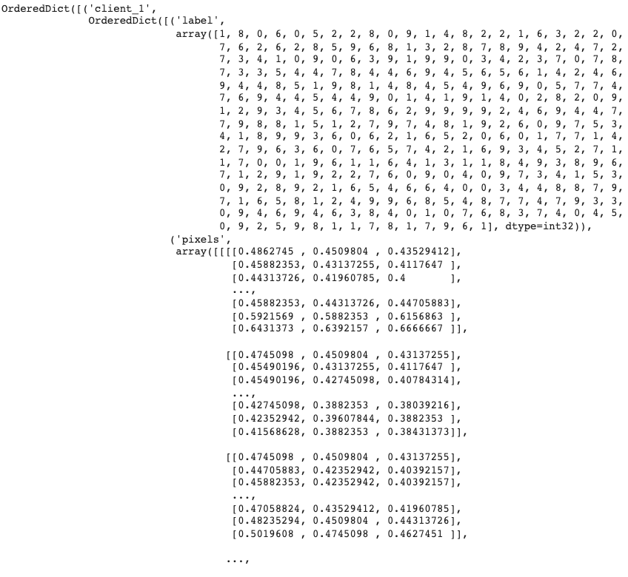
Converting Data into Federated Data Set
The federated data sets do not take standard image inputs
The federated data needs to be an ordered dictionary with the tensor format of the clients and their associated labels and pixel values
For our use case, we utilize 4 clients, each using image data captured at a specific angle associated with the respective client

Slide 12
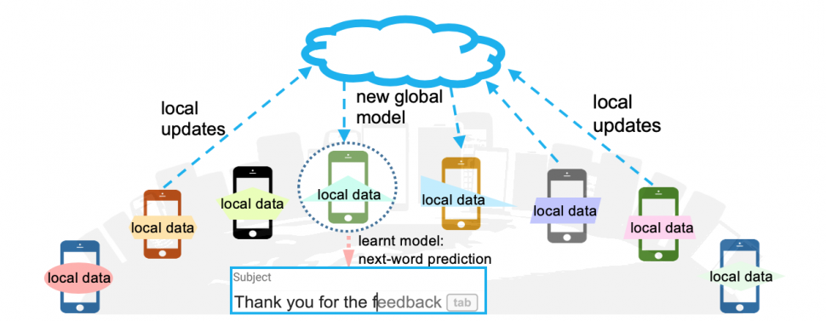
Federated Training Overview
We used a federated library built on Tensorflow
The model is defined by a process with 2 key steps: the client training & the server updates
1st, the client training portion runs the machine learning algorithm on each client independently
2nd, those learned model weights are sent back to the server model for federated averaging. The updated, global weights are then communicated back to the clients
Source: Li, Tian; Federated Learning: Challenges, Methods, and Future Directions; November 12, 2019

Slide 13
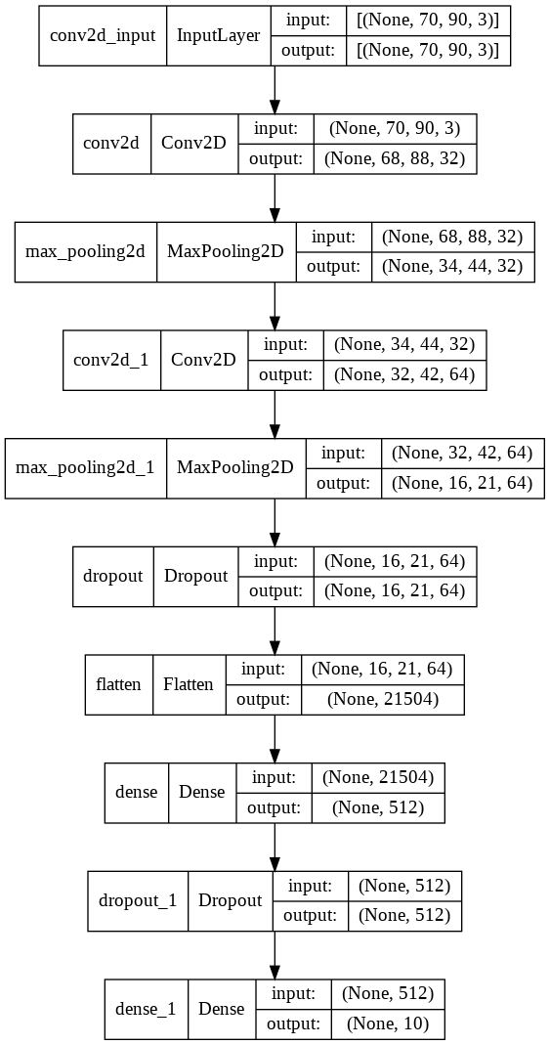
Federated Training Process on Our Data
The training took place over 10 rounds of client training/server updates
For the final model, the clients trained the 3-channel image data on a small convolutional neural network – its architecture pictured on the figure to the right

Slide 14
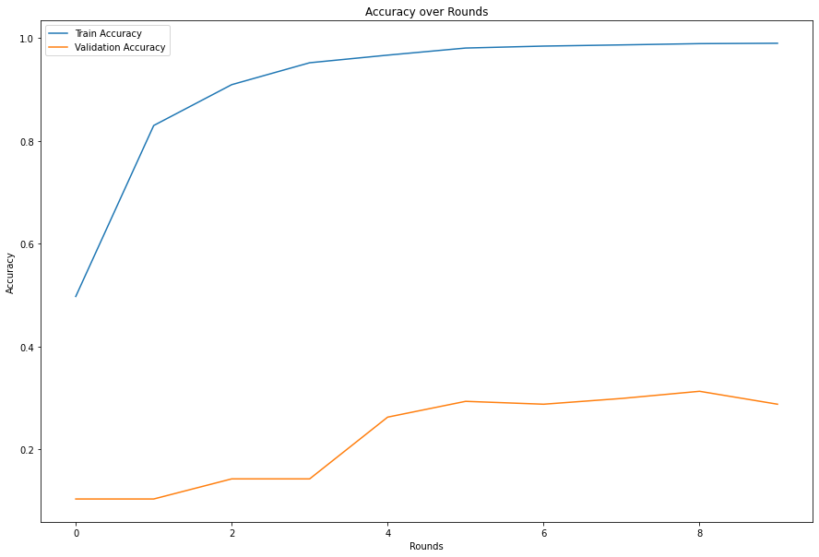
Federated Training Results on Our Data
The overall validation accuracy of the model reached just under 35%
The relatively small dataset leads to the accuracy being capped at such a level
This also is evident in the overfitting that occurs on the model that could not be resolved

Slide 15
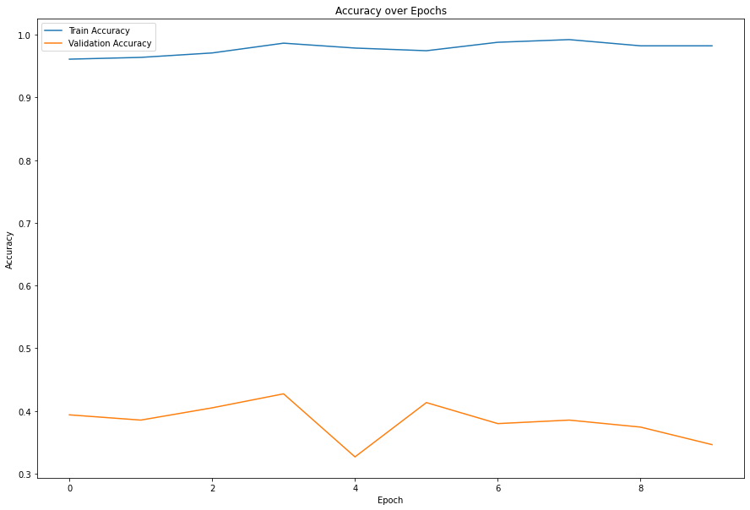
Alternative Results
We tried aggregating all the client data into a single dataset to train on the standalone convolutional neural network
All applicable hyperparameters were match with what was used on the Federated Learning model
This model showcases a comparable validation accuracy in relation to the Federated training results

Slide 16
Conclusion and Future Work
Federated Learning helped us achieve a result just as good as convolutional neural network with a small data set
With a slightly larger data set, our accuracy would improve significantly
The images were taken from a small area, but with a diverse image set, we may be able to improve the accuracy of the model
This algorithm can be used for other domains as well
Some other applications are identifying the quality of rice on a conveyor belt

Slide 17
Thank You

